Slide 1
CS61C: Great Ideas in Computer Architecture (aka Machine Structures)
Lecture 24: Introduction to Performance Programming
Instructors: Dan Garcia, Justin Yokota

Slide 2
Agenda
Introduction
Timing
Amdahl's Law
Case Study: Matrix Multiplication
Single-threaded improvements

Slide 3
Introduction
Part 1 of this course: How a computer works
C->RISC-V->circuit level
Part 2: How to optimize a program
Pipelining
Parallelism
Caching/VM
Today: Optimizations we can make without parallelism

Slide 4
Measuring Runtime: The <time.h> library
Human time is weird
Leap years and leap seconds are inconsistent, and hard to work with.
Most systems use epoch time, defined as the number of seconds since some historical event
The most common epoch is Unix time, which starts January 1, 1970, 00:00:00 GMT
Using this time with a 32-bit signed integer causes an overflow in January 2038, which may cause a large number of bugs in 32-bit programs…
C has several functions for this, in addition to a clock() function, which measures the amount of time from the start of a program
As a reminder, green slides are not considered in scope, but provide useful background information

Slide 5
Measuring Runtime: The <time.h> library
General approach for measuring a program's runtime:
Step 1: Before you run the program, call clock to get the start time of your program
Step 2: Run your program
Step 3: Call clock again and take the difference. To get the runtime in seconds, divide by CLOCKS_PER_SECOND
Make sure you typecast to a double or float; otherwise, your time will be an integer.
This still ends up rounding results to the nearest millisecond and random lag spikes can occur, so it's sometimes useful to run the same test multiple times and take the average.
Often useful to time individual parts of your program separately; this lets you see which parts of your code are taking the most runtime

Slide 6
Amdahl's Law: Analogy
Overall: 50 mi/hr
25 mi/hr average | ? average
Berkeley
Midpoint
San Jose
You're driving from Berkeley to San Jose.
For the first half of the distance, you average 25 miles/hour.
How fast do you need to travel for the second half, in order to average 50 miles/hour overall?

Slide 7
Amdahl's Law: Analogy
Overall: 50 mi/hr -> 1 hour total
25 mi/hr -> 1 hour spent | ? average -> 0 hours spent
Berkeley: 0 miles
Midpoint: 25 miles
San Jose: 50 miles
Assume Berkeley-San Jose is 50 miles (the math works out regardless of the actual distance, so we can just pick a distance)
First half: 25 miles at 25 mph = 1 hour
Overall: 50 miles at 50 mph = 1 hour
Time left for second half: 25 miles in 0 hours -> We need to travel at ∞ mph

Slide 8
Amdahl's Law
Overall: 2x speed
1x speed | ? average
Start
Half original runtime
End
You're trying to speed up a program.
The first half of the code can't be sped up.
How many times faster do you need to make the second half of the code, if you want to overall get a 2x speedup?
Infinitely faster!

Slide 9
Amdahl's Law
AKA the bane of performance programming
"The maximum speedup we can attain with our code is limited by the fraction that cannot be sped up"
If we speed up 95% of our code, we can get at most a 20x speedup
Almost any optimization we discuss from now on will only affect one portion of your code. If you only focus on one part, you'll eventually be unable to continue optimizing.
Formal equation: Speedup = 1/((1-F)+F/S), where F is % of code that you speed up and S is how many times faster you make that part.
That's annoying to work with; much easier to treat these problems as word problems instead

Slide 10
Amdahl's Law: Example
1x speed | 100x speed
Start
End
You have an optimization that speeds up the foo function by 100x
Unfortunately, the runtime of foo was only 25% of our original code's runtime. How many times faster have we made our code overall?

Slide 11
Amdahl's Law: Example
1x speed | 100x speed
Start
End
Strategy one: Use the formula
1/((1-F)+F/S) -> 1/((1-0.25)+0.25/100) = 1/(0.7525) ≈ 1.33x speedup

Slide 12
Amdahl's Law: Example
75 sec, 1x speed | 25 sec, 100x speed
75 sec, 1x speed
Start
End
Strategy two: Assign values
Let's say that our original code took 100 seconds to run
Total runtime is now 75 seconds for part 1, .25 seconds for part 2 = 75.25 seconds
Speedup = 100 seconds / 75.25 seconds ≈ 1.33x speedup

Slide 13
Amdahl's Law in the Real World
Excerpts from FY 2021 US Federal budget:
"The Budget proposes to eliminate nearly $2 million for duplicative Government-funded online English-language learning programs"
"The Budget invests $15.1 billion in DOD's tactical fighter programs, continuing the procurement of F-35A stealth fighters and [other stealth fighters]"
Eliminating small items tends to be easy. Cutting large items tend to be hard.
Cut of $2 million affects budget 7,500x less than $15,100 million fighter jet budget
Citation: BUDGET-2021-BUD.pdf (govinfo.gov)

Slide 14
Amdahl's Law: Consequences
In order to properly speed up your code, you need to know which parts of your code are taking the runtime
Test your code to help analyze where your runtime's going
Check multiple sizes, check repeatedly (since there might be variation between runs)
Check each component independently
Our autograders will only give you overall speedup, which doesn't help much in determining where you can speed things up further.

Slide 15
Amdahl's Law: Consequences
In order to properly speed up your code, you need to know which parts of your code are taking the runtime
Test your code to help analyze where your runtime's going
Check multiple sizes, check repeatedly (since there might be variation between runs)
Check each component independently
Our autograders will only give you overall speedup, which doesn't help much in determining where you can speed things up further.

Slide 16
Case Study: Matrix Multiplication
Given 2 matrices A, B, return AB
For simplicity, assume for now:
Each matrix is square
Each matrix is row-major
Matrix dimensions are multiples of some large power of 2
Strassen Algorithm doesn't exist. We're stuck with basic O(n³) matrix multiplication
Matrix multiply forms the basis of many complex algorithms (ex. neural networks, component analysis)
 |  |  |  |  | 17 | 18 | 19 | 20
 |  |  |  |  | 21 | 22 | 23 | 24
 |  |  |  |  | 25 | 26 | 27 | 28
 |  |  |  |  | 29 | 30 | 31 | 32
1 | 2 | 3 | 4
5 | 6 | 7 | 8
9 | 10 | 11 | 12
13 | 14 | 15 | 16

Slide 17
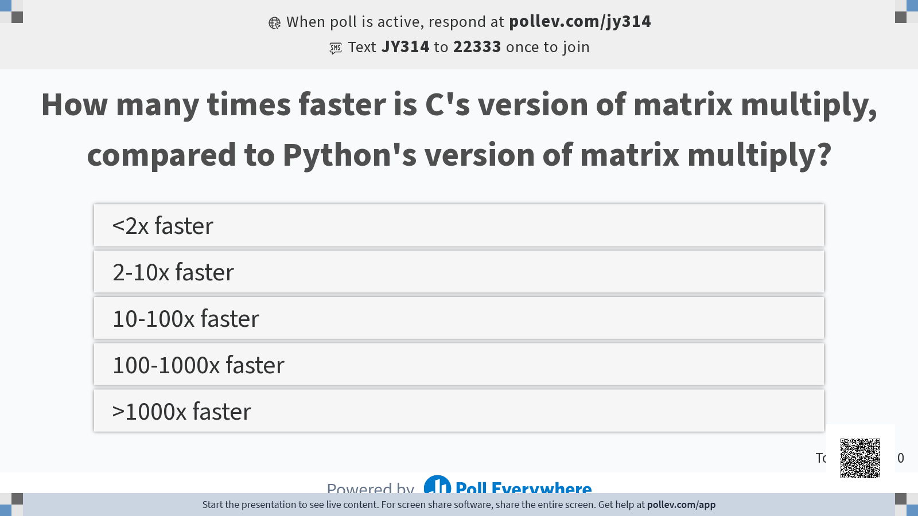

Slide 18
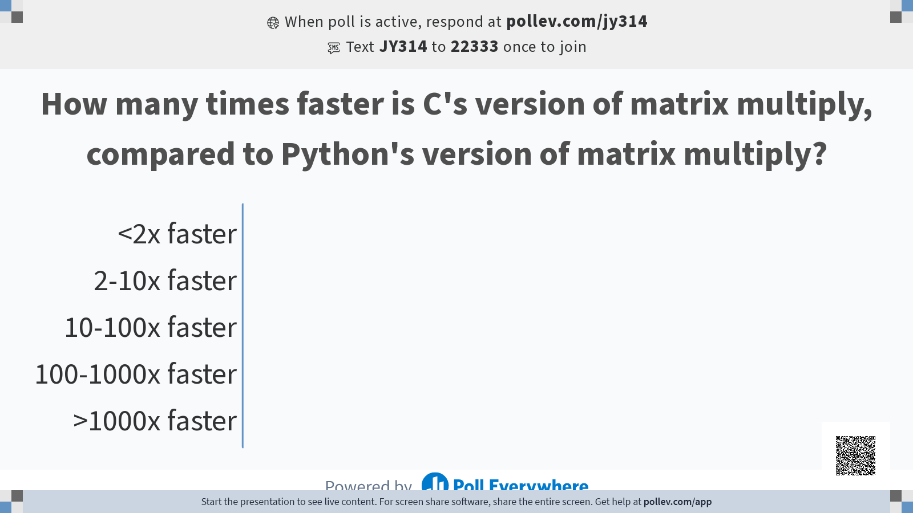

Slide 19
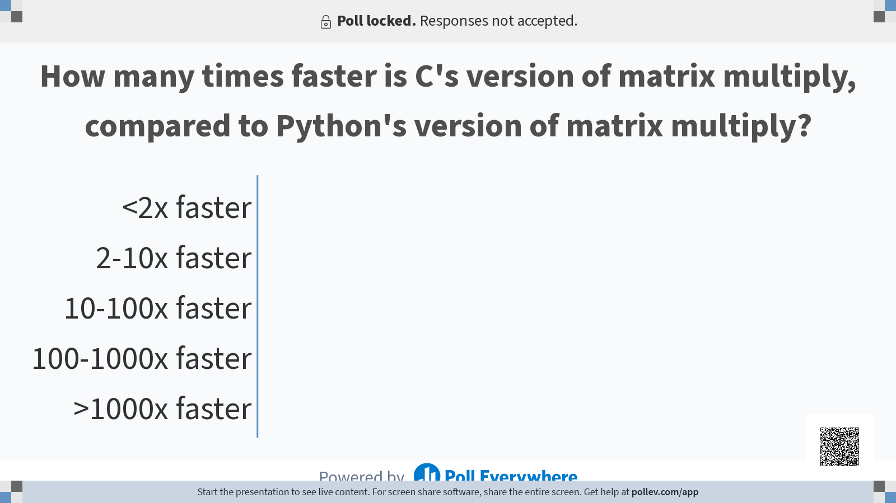

Slide 20
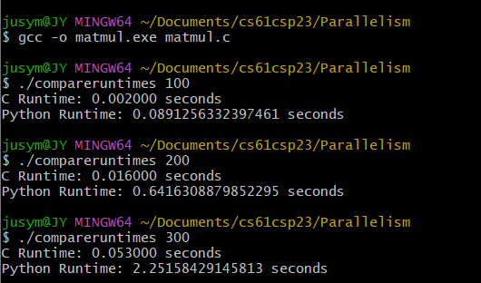
Version 1: Matrix Multiply in C

Slide 21
Version 1: Matrix Multiply in C
Just by switching from Python to C, we get a ~40x speedup
This is actually better than it used to be; Python 3.11 came out last semester, and sped up Python by a LOT.
Downside: It is hard to write code in C.
Is this enough?
NO. WE NEED MOAR SPEED!
Also, Python's numpy library (which uses a C library) still beats us by a factor of 10
How do we improve our runtime?

Slide 22
Operation Time Costs
As a general rule of thumb, the runtime cost of operations gets broken down as follows:
File operations
Extremely slow (retrieving from disk, so it takes a long time)
Also includes prints and other I/O, so it's a good idea to avoid printing lots of data when testing runtime.
Memory operations
~100x faster than file operations (accessing RAM)
Can be improved through caching, but memory operations still take 10-100 clock cycles
Branches and Jumps
Slower than most operations due to hazards (potentially 5 clock cycles)
Can be improved through loop unrolling
Arithmetic operations
Fastest operations (1 cycle ideally, though some operations take longer)

Slide 23
Operation Time Costs in Matrix Multiply
File operations
Θ(N²) operations, no real way to optimize this
Memory operations
Θ(N³) operations; can be reduced by constant factors
Branches, Jumps, and Arithmetic operations
Θ(N³) operations; can be reduced by constant factors
Since the number of memory operations and Branch/Jump/Arithmetic operations are similar, memory operations will likely take the majority of runtime. Thus saving memory operations will have a larger impact on our runtime, even if it increases calculation steps.

Slide 24
Optimization 1: Loop Unrolling and Function Inlining
Main idea: Since branches and jumps take a long time, reduce the number of jumps/branches needed to run a program
Function inlining: Replace a function call with the body of that function
Loop unrolling: Increase the number of steps done per iteration of a loop
int f(int i) {return i*i;}
for(int i = 0; i < max; i++) { arr[i] = f(i); }
int i = 0; for(; i < max/4; i+=4) { arr[i] = i * i; arr[i+1] = (i+1) * (i+1); arr[i+2] = (i+2) * (i+2); arr[i+3] = (i+3) * (i+3); } for(; i < max; i++) { arr[i] = i * i; }

Slide 25
Optimization 1: Loop Unrolling and Function Inlining
Main idea: Since branches and jumps take a long time, reduce the number of jumps/branches needed to run a program
Function inlining: Replace a function call with the body of that function
Significant reductions in runtime due to not having to set up the stack, deal with calling convention, etc.
Can also request the compiler inline a function for you with the inline keyword; i.e. inline int f(int i)
Loop unrolling: Increase the number of steps done per iteration of a loop
Reduces runtime due to fewer branches, and can have a surprisingly large impact
Often done automatically by the gcc compiler, but manually unrolling can improve runtime over the automated system

Slide 26
Loop Unrolling and Function Inlining Limitations
Generally causes your code file/resulting executable to be larger
If your loop is too large, you end up exceeding your branch immediate, and take a large penalty to runtime
The inline keyword is only a suggestion to the compiler; gcc is perfectly free to ignore the keyword entirely.
Loop unrolling is already done by some compilers, so speedup may be minimal/hard to predict
Major: Loop unrolling makes your code much harder to read and modify. Thus it's generally best to only unroll at the end, or to save a rolled version of your code for later use.

Slide 27
Optimization 2: Variable Caching
Main idea: Save commonly used values in variables, instead of forcing recomputations
Additionally, save commonly used variables in registers, instead of saving them on the stack. The register keyword can be used to request a variable gets put in a register
x86 is the assembly language commonly used by PCs, and has fewer registers than RISC-V does. Thus, most variables get stored in the stack, instead of in registers.
for(int i = 0; i < max/4; i++) { f(i); }
register int i = 0; register int maxoverfour = max/4; for(; i < maxoverfour; i++) { f(i); }

Slide 28
Variable Caching Limitations
Limited by the number of registers available
Since different CPUs can have different registers, this makes your performance more dependent on the architecture than before, which means:
You need to know how the architecture works to optimize your code
Your code will work slower on a different architecture
As before, the compiler tends to do some of this already, so getting speedup can be inconsistent. The register keyword is also only a suggestion, and the compiler is free to ignore the keyword.

Slide 29
Optimization 3: Data Caching
Variable caching: Save commonly used variables in registers
Accessing main memory takes hundreds of clock cycles
Data caching: Save commonly used data "closer" to the CPU, so we can access it in fewer cycles (~10 cycles)
Even better: Predict what data you need and bring that data closer to the CPU before we even access it
The exact mechanics of this are complicated enough that we have a full lecture sequence on them: see Caches
For today: accessing adjacent memory addresses will be on average faster than accessing nonadjacent memory addresses

Slide 30
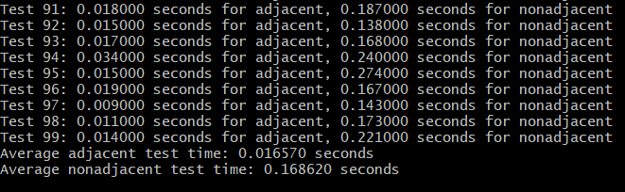
Data Caching Example

Slide 31
Data Caching for Matrix Multiplication
Assuming we do a naive matrix multiplication, data gets accessed in row-major order for two matrices, and column-major order in one matrix
Thus, really fast to access two matrices, really slow to access the third.
Optimization: Transpose the third matrix before starting calculations, so we get fast accesses on all matrices
 |  |  |  |  | 17 | 18 | 19 | 20
 |  |  |  |  | 21 | 22 | 23 | 24
 |  |  |  |  | 25 | 26 | 27 | 28
 |  |  |  |  | 29 | 30 | 31 | 32
1 | 2 | 3 | 4
5 | 6 | 7 | 8
9 | 10 | 11 | 12
13 | 14 | 15 | 16

Slide 32
Data Caching for Matrix Multiplication
Assuming we do a naive matrix multiplication, data gets accessed in row-major order for two matrices, and column-major order in one matrix
Thus, really fast to access two matrices, really slow to access the third.
Optimization: Transpose the third matrix before starting calculations, so we get fast accesses on all matrices
 |  |  |  |  | 17 | 21 | 25 | 29
 |  |  |  |  | 18 | 22 | 26 | 30
 |  |  |  |  | 19 | 23 | 27 | 31
 |  |  |  |  | 20 | 24 | 28 | 32
1 | 2 | 3 | 4
5 | 6 | 7 | 8
9 | 10 | 11 | 12
13 | 14 | 15 | 16

Slide 33
Data Caching for Matrix Multiply
Optimization: Transpose the third matrix before starting calculations, so we get fast accesses on all matrices
Transposing adds Θ(N²) slow memory accesses, but converts Θ(N³) slow memory accesses into fast memory accesses. Thus, this should be faster for large matrices, but slower for small matrices.
Any way to get the best of both worlds?
Decide on a threshold; if the size of the matrix is smaller than the threshold, use the naive approach, and if the size of the matrix is larger than the threshold, use the transpose approach
How to decide threshold?
Run tests on a representative machine to find where the break-even point is.

Slide 34
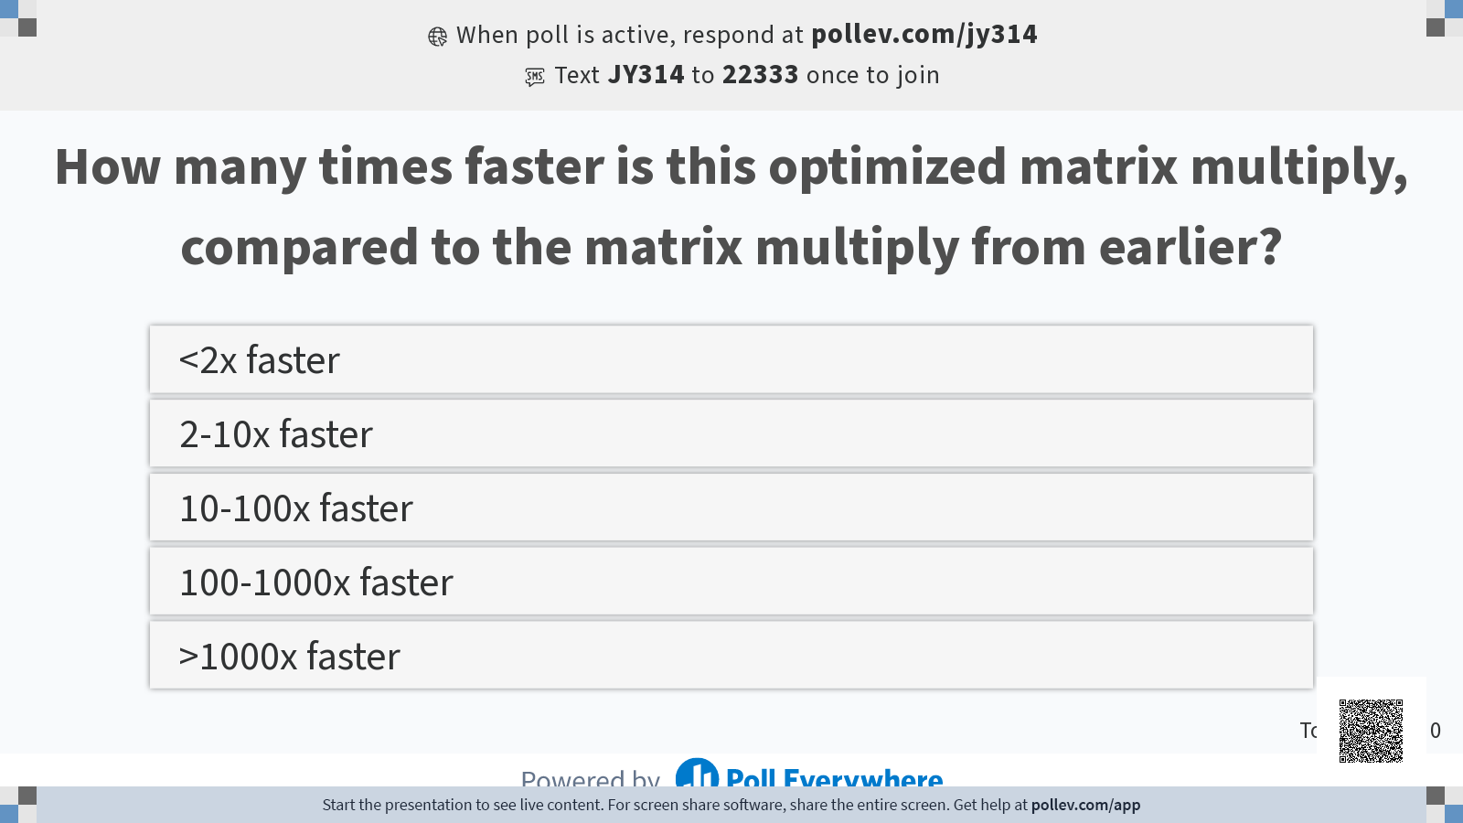

Slide 35
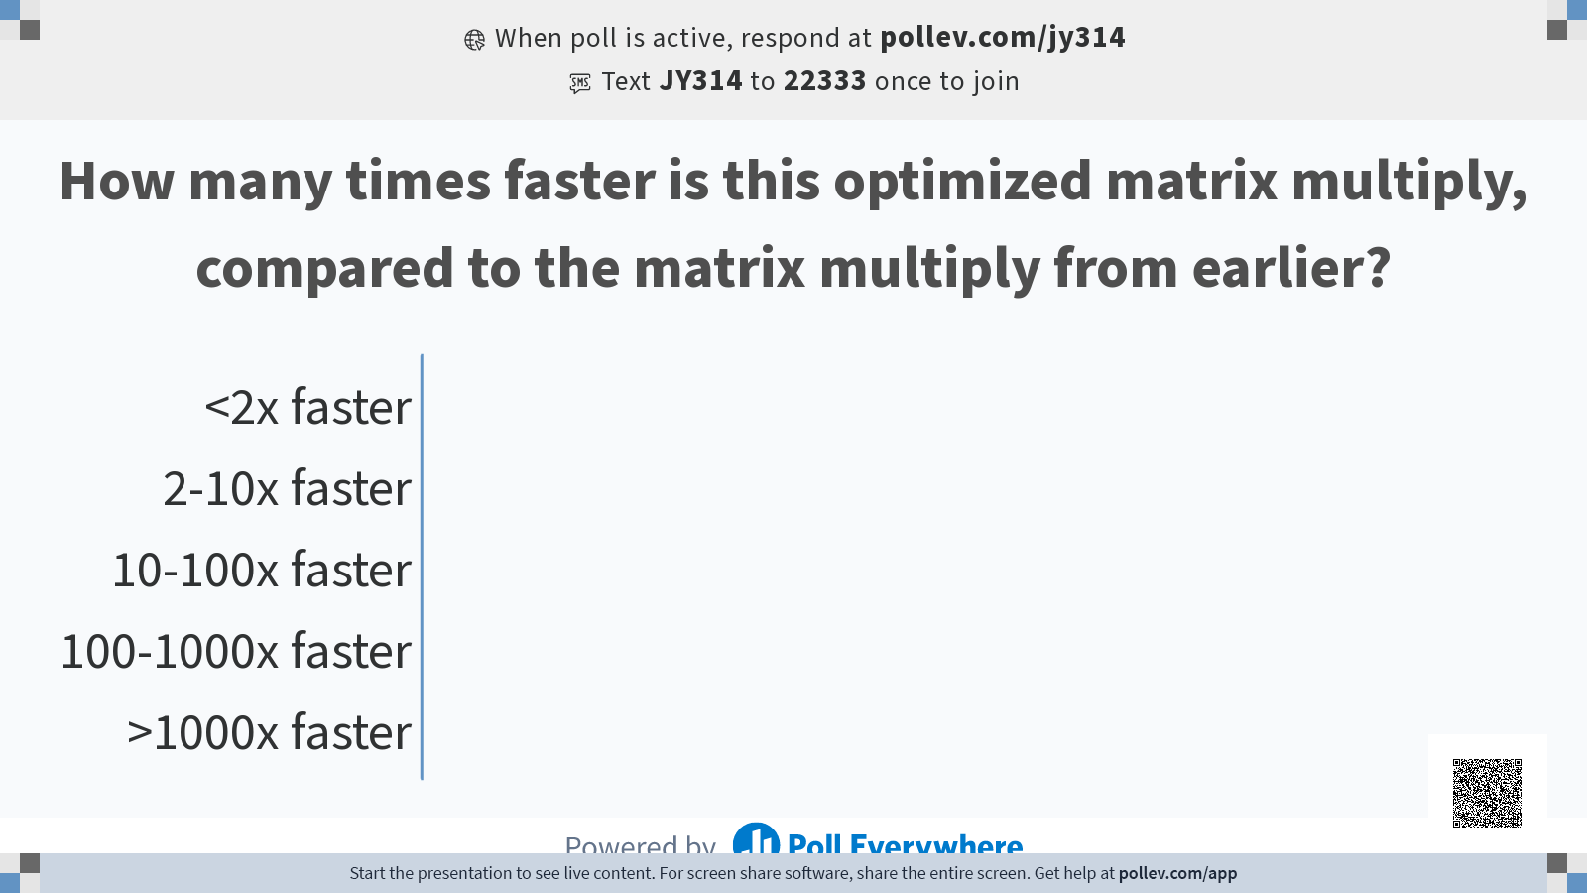

Slide 36
